Slide 1
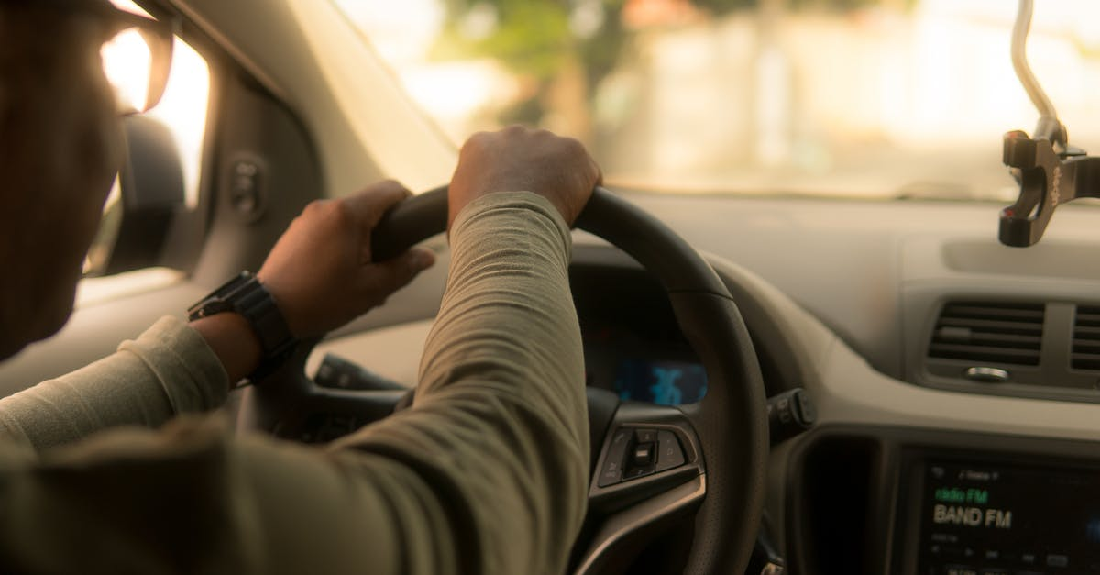
License Plate Recognition and Application: E-Challan
-Smart transportation

Slide 2
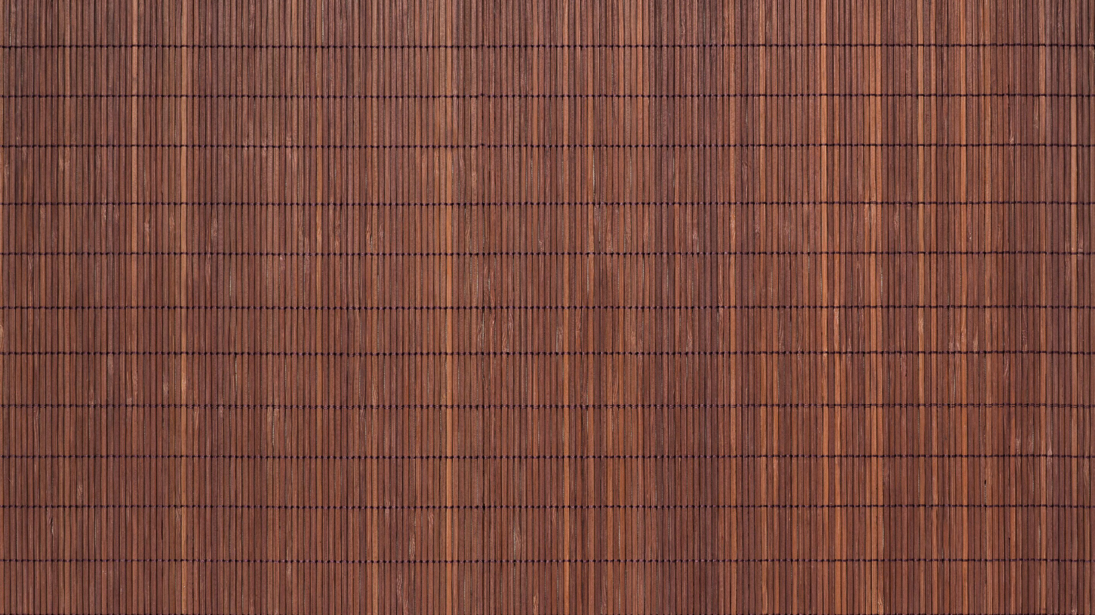


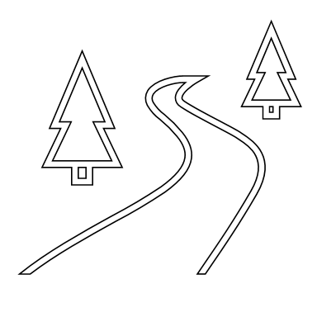

Contents:
Introduction
Software Components
Models Description
Inputs
Working
Results
Fail cases
Future scope
References

Slide 3

Introduction:
Recognition of the license number plate of vehicles is significant for the control and surveillance systems.
It's a hard and intensive job for humans to manually recognize all the vehicle number plates.
Hence, our aim is to build an efficient license number plate recognition system using deep learning that is extended to an application of E-challan.

Slide 4


Software components:
Software : PyCharm for coding, Kaggle for training.
Language : Python
Required Python Modules : OpenCV, matplotlib, Keras, TensorFlow, tkinter, sqlite3,MIMEtext
Model used for Plate Detection : Wpod-net (Warped Planar Object Detection Network) architecture (pre-trained model)
Model used for Character Recognition : MobileNetv2 architecture

Slide 5


Models Description:
I. Wpod-net Architecture
21 convolutional layers of 3x3 size.
14 residual blocks.
ReLU activation function.
4 max pooling layers of 2 × 2 size.
Detection block.
II. MobileNetV2 Architecture
It has three advanced structures:
~ Depth wise separable convolution.
~ Linear bottleneck.
~ Inverted residual.
In a specific block, it has three layers:
~ 1×1 size convolution with ReLU6.
~ depth wise convolution layer of 3x3 size.
~ 1×1 convolution layer, with linearity.

Slide 6

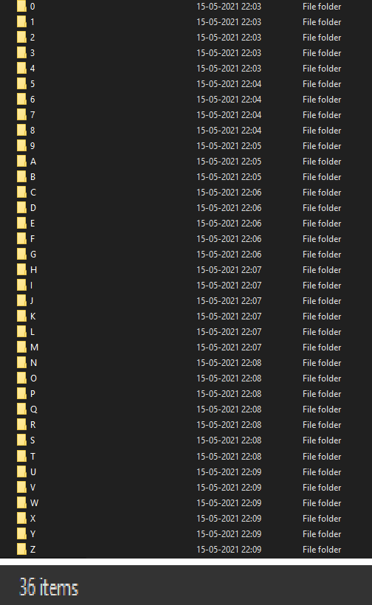
Inputs:
Classes: 36 (A-Z, 0-9)
Dataset: 37623 images
Training-Validation images ratio: 9:1
Epochs: 30
Database: 100 records

Slide 7




Working:
Number plate detection
Pre-processing of the image
Segmentation of characters
Training model to detect characters
Sending emails to vehicle owners
SQL database creation & linking with python
GUI creation
Character recognition

Slide 8
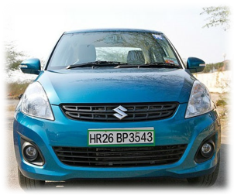

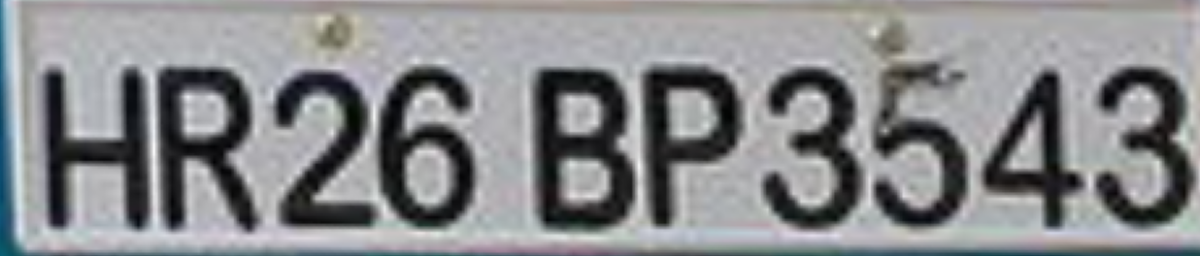
Number plate detection:

Slide 9
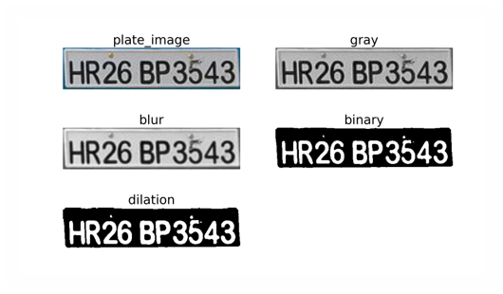
Pre-processing of number plate:

Slide 10
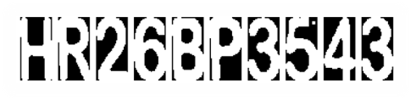
Segmentation of characters:

Slide 11
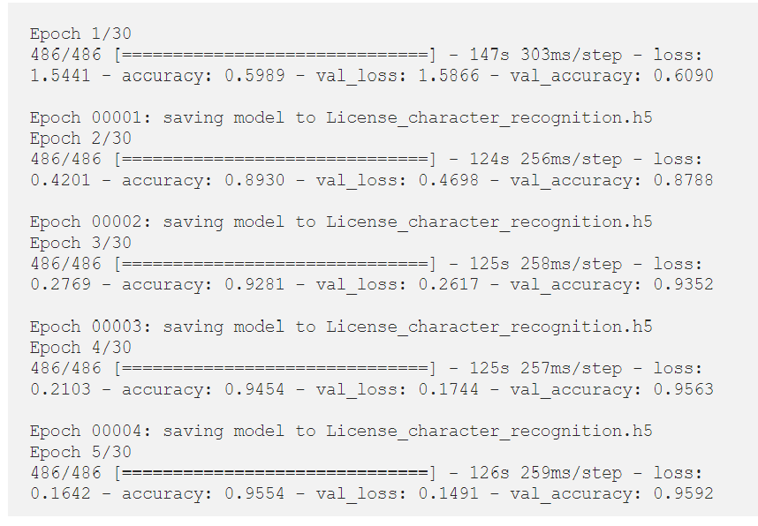
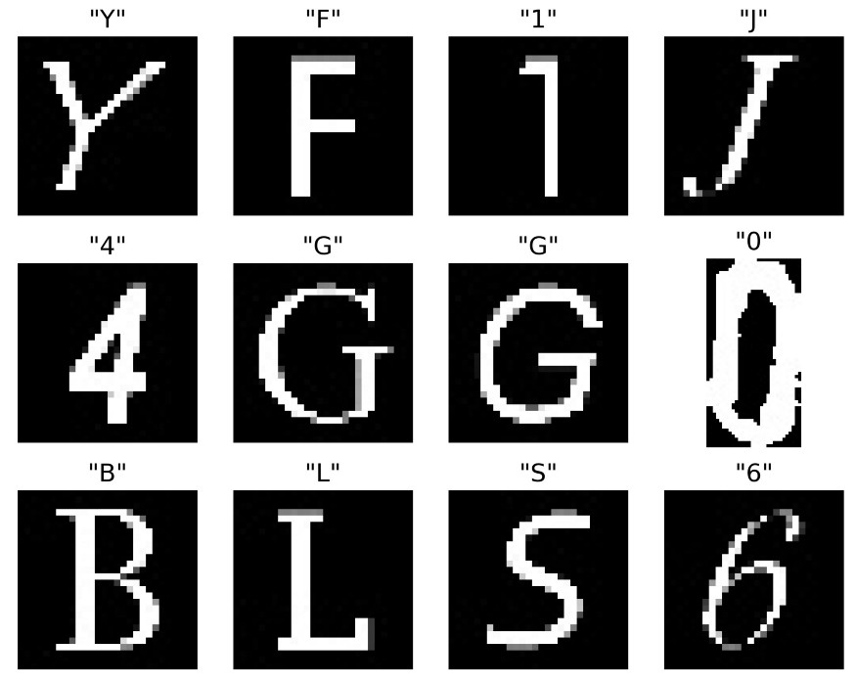
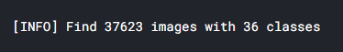
Training model to detect characters:
1
2
3

Slide 12
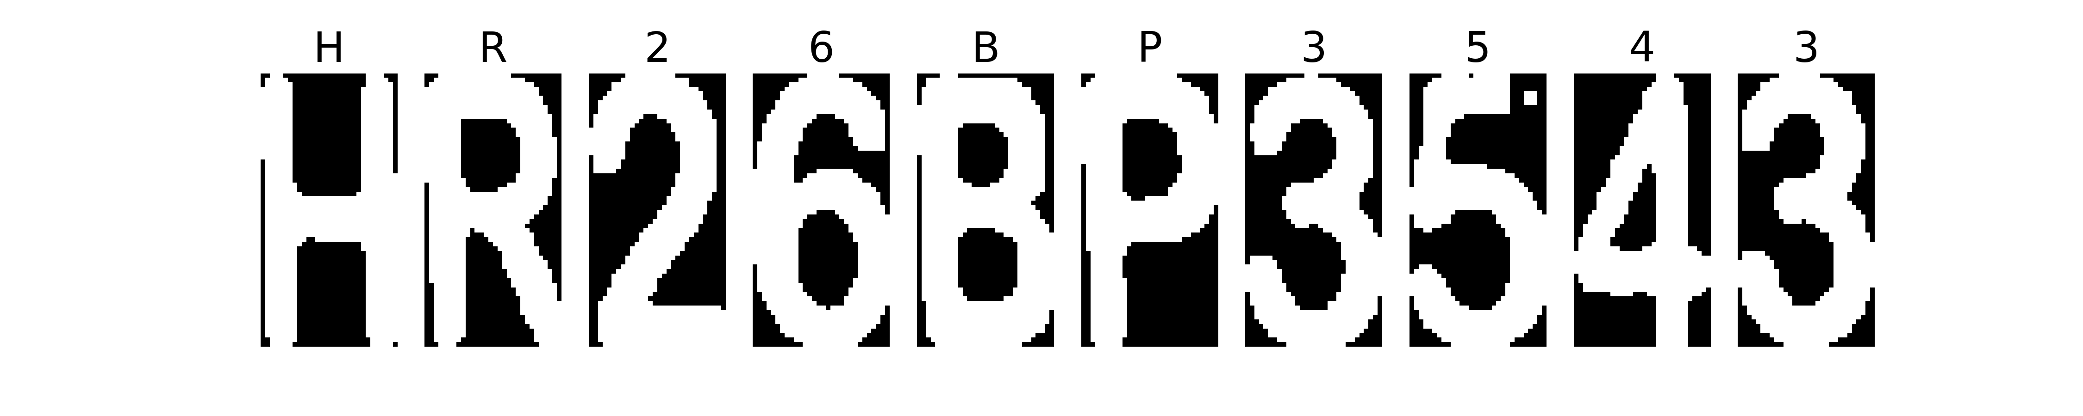
Character recognition:
Output text: HR26BP3543

Slide 13
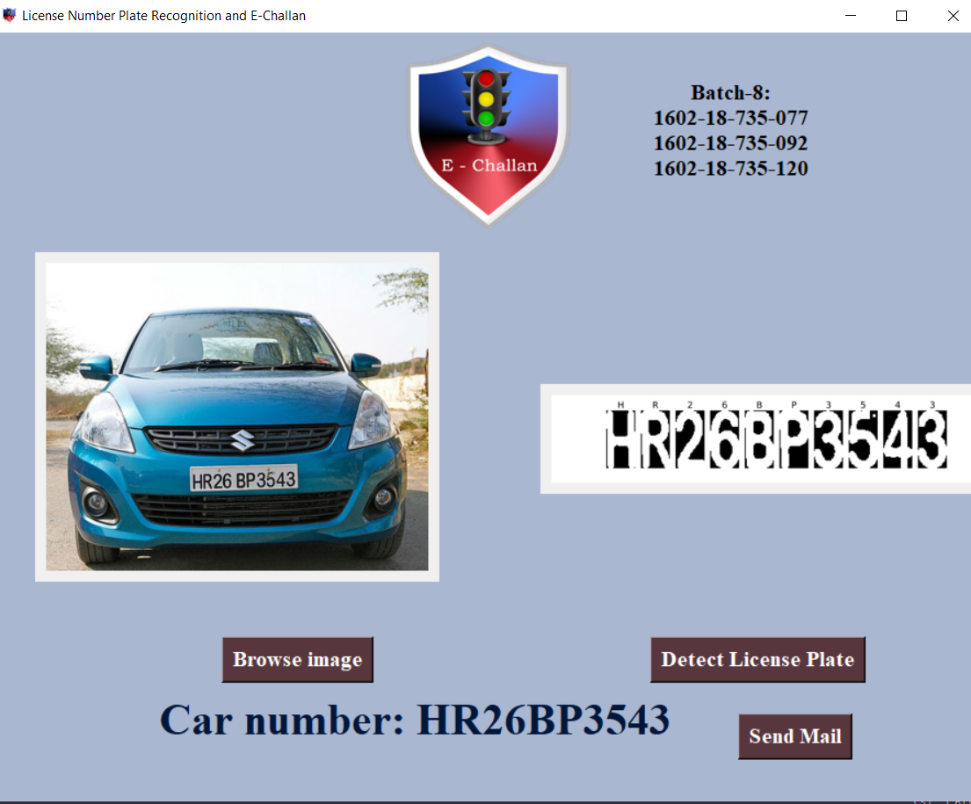
GUI creation:

Slide 14
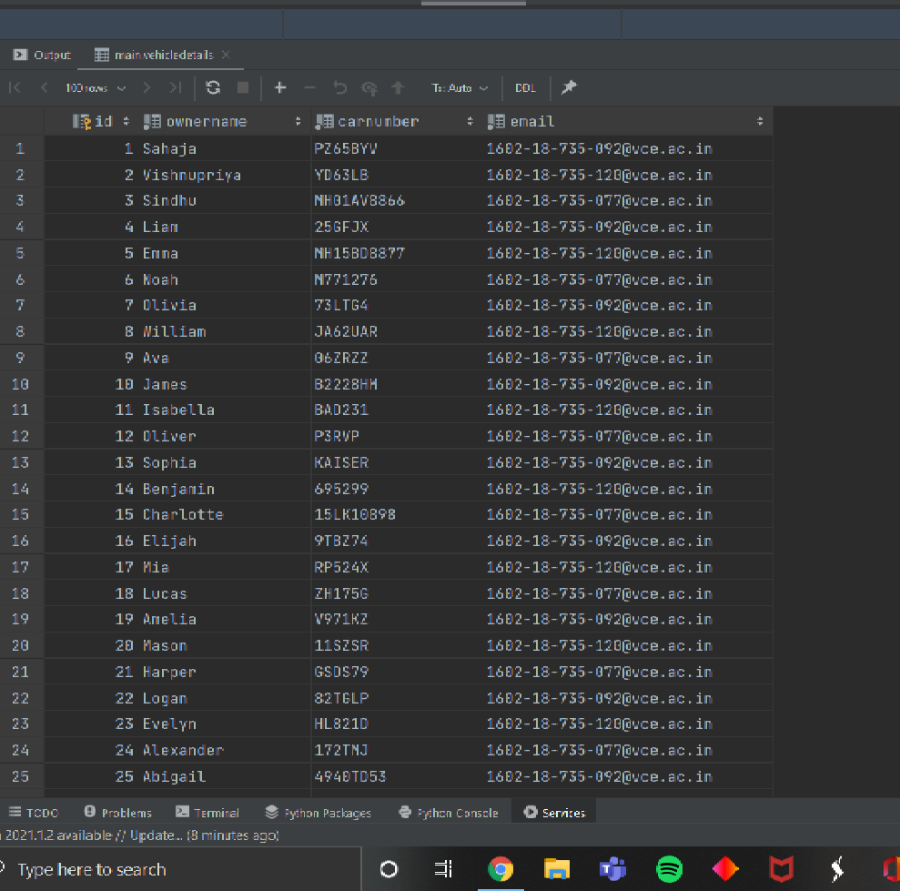


SQL database creation & interlinking with python:

Slide 15
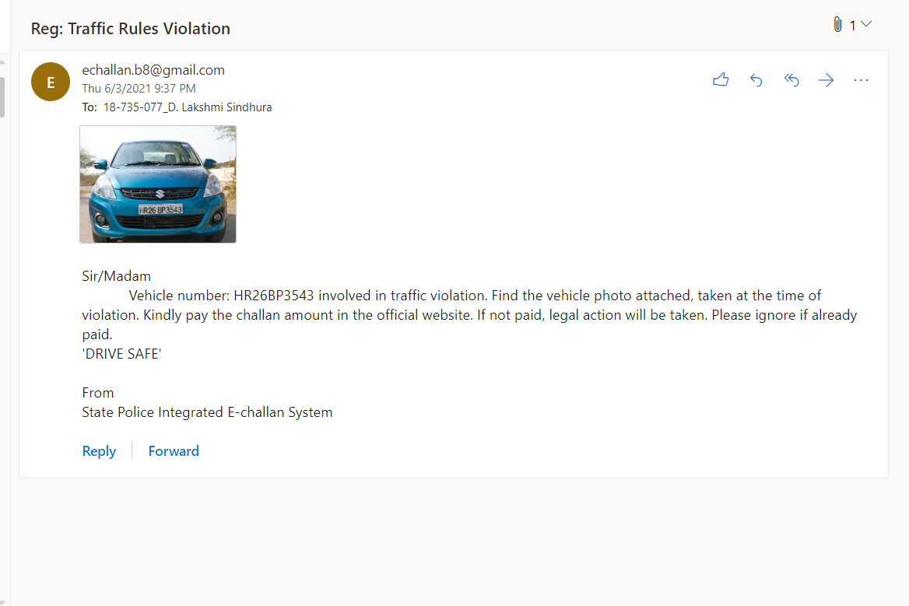



Sending emails to vehicle owners:

Slide 16

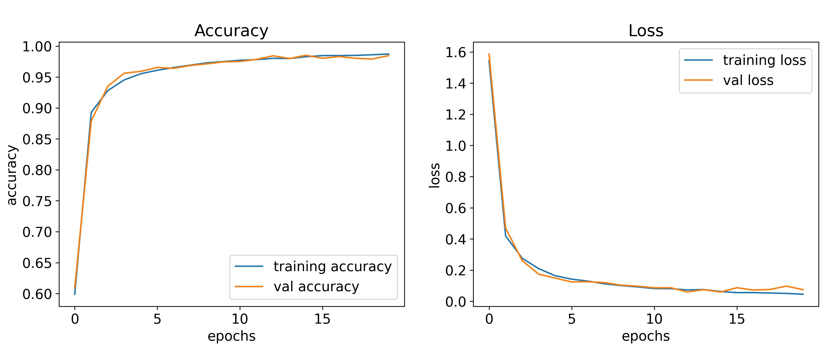
Results:
Training accuracy: 98.03%
Training loss: 5.86%
Validation accuracy: 97.34%
Validation loss: 8.69%

Slide 17

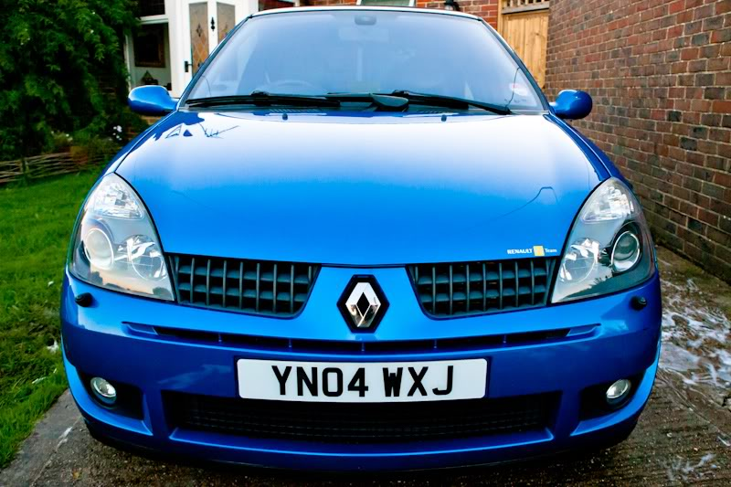
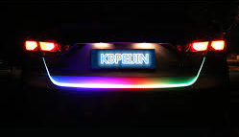
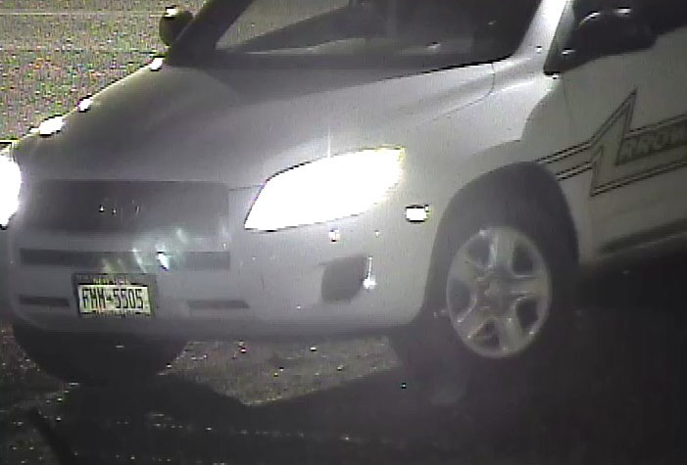
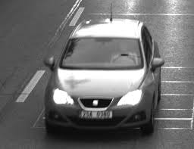
Fail cases :
3. Lights behind the license plate
1. Confusion between certain characters:
'O' and '0'
'4' and 'A'
' I ' and '1'
2. Poor lighting
4. Blur image

Slide 18


Future scope:
Accuracy of the recognition can be increased to detect poor-quality images also.
Another pre-processing feature can be implemented on poor-quality images to add details to the pictures in order to increase the model accuracy.
Other features like time, place, date and reason of violation can be added in the mail.

Slide 19

References:
Montazzolli, Sérgio & Jung, Claudio. (2018). License Plate Detection and Recognition in Unconstrained Scenarios. ( Link: https://openaccess.thecvf.com/content_ECCV_2018/papers/Sergio_Silva_License_Plate_Detection_ECCV_2018_paper.pdf )
https://techvidvan.com/tutorials/python-project-license-number-plate-recognition/
https://medium.com/@quangnhatnguyenle/detect-and-recognize-vehicles-license-plate-with-machine-learning-and-python-part-1-detection-795fda47e922
Dataset and wpod-net pre trained model:
https://github.com/quangnhat185/Plate_detect_and_recognize
https://realpython.com/python-send-email/

Slide 20
THANK YOU
-D.L.SINDHURA(077)
-P.SAHAJA(092)
-S.VISHNUPRIYA(120)

